Slide 1
Random cheese update
Jens Stevens
February 18 2021

Slide 2
Things to talk about
Severity layers
Processing severity layers
Patch distributions: simulating reality
Scar intersection analysis

Slide 3
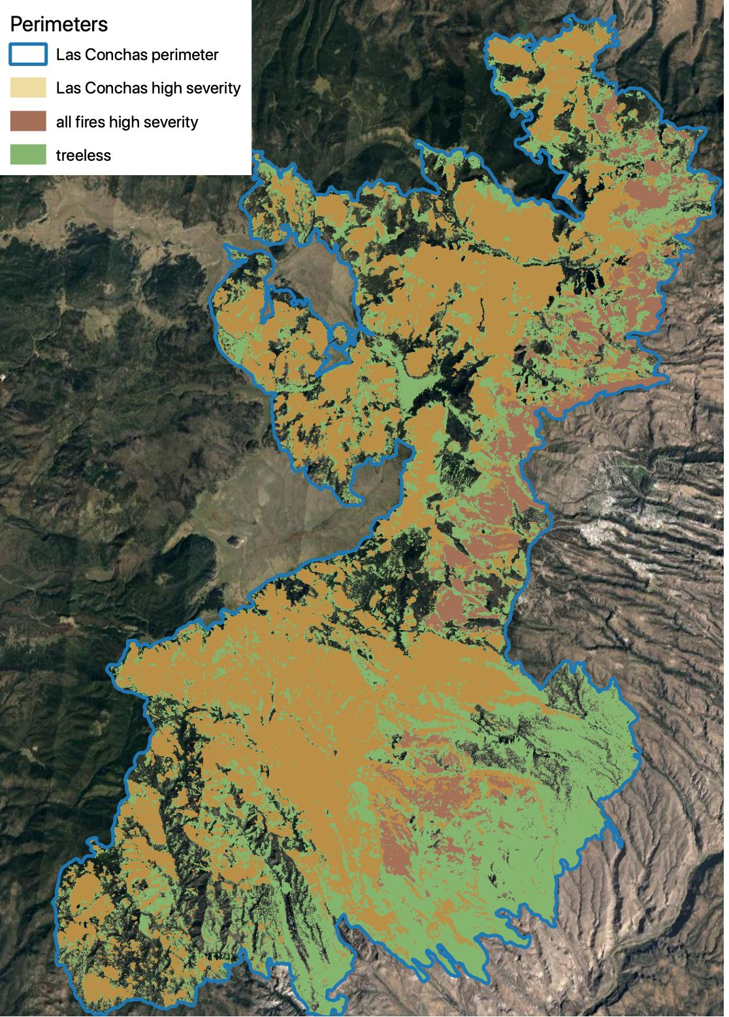
1: severity layers
Sean developed “Las Conchas” and “all fires” (using all intersecting perimeters).
30 m resolution, “predicted CBI” following Parks et al. 2019
“all fires” includes LC plus other fires with >10 ha intersecting high severity
Dome (‘96) 1253 ha; Oso (‘98) 605 ha; Cerro Grande (‘00) 2789 ha
Coop “treeless” layer is most expansive

Slide 4
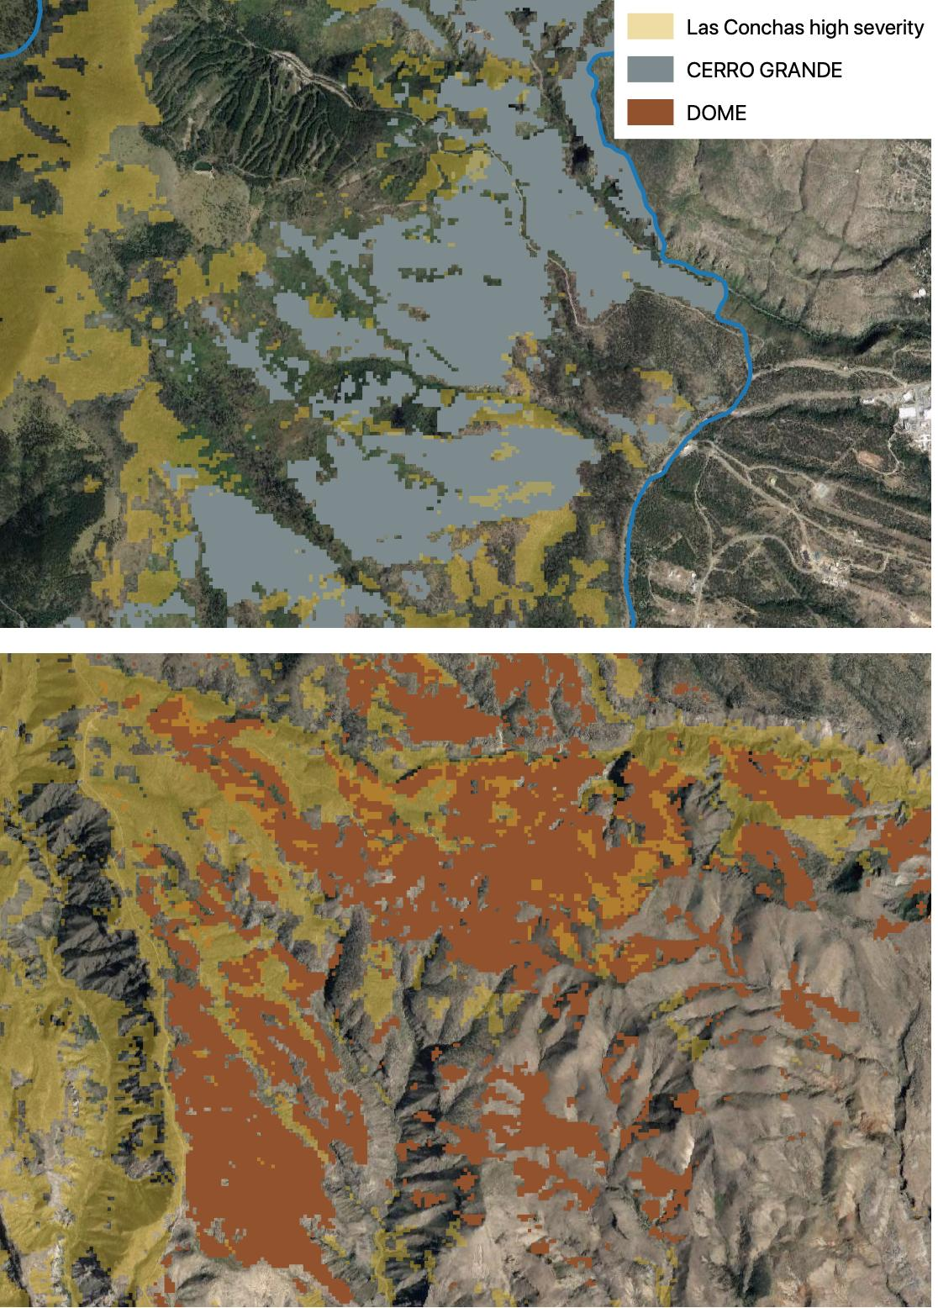
1: severity layers - issues
3 scenarios: lc, all, treeless
Goal is to bracket “reality”
The CBI method means the “lc” layer does not capture re-burned high-severity well (see examples)
True reality probably lies between “all” and “treeless”

Slide 5
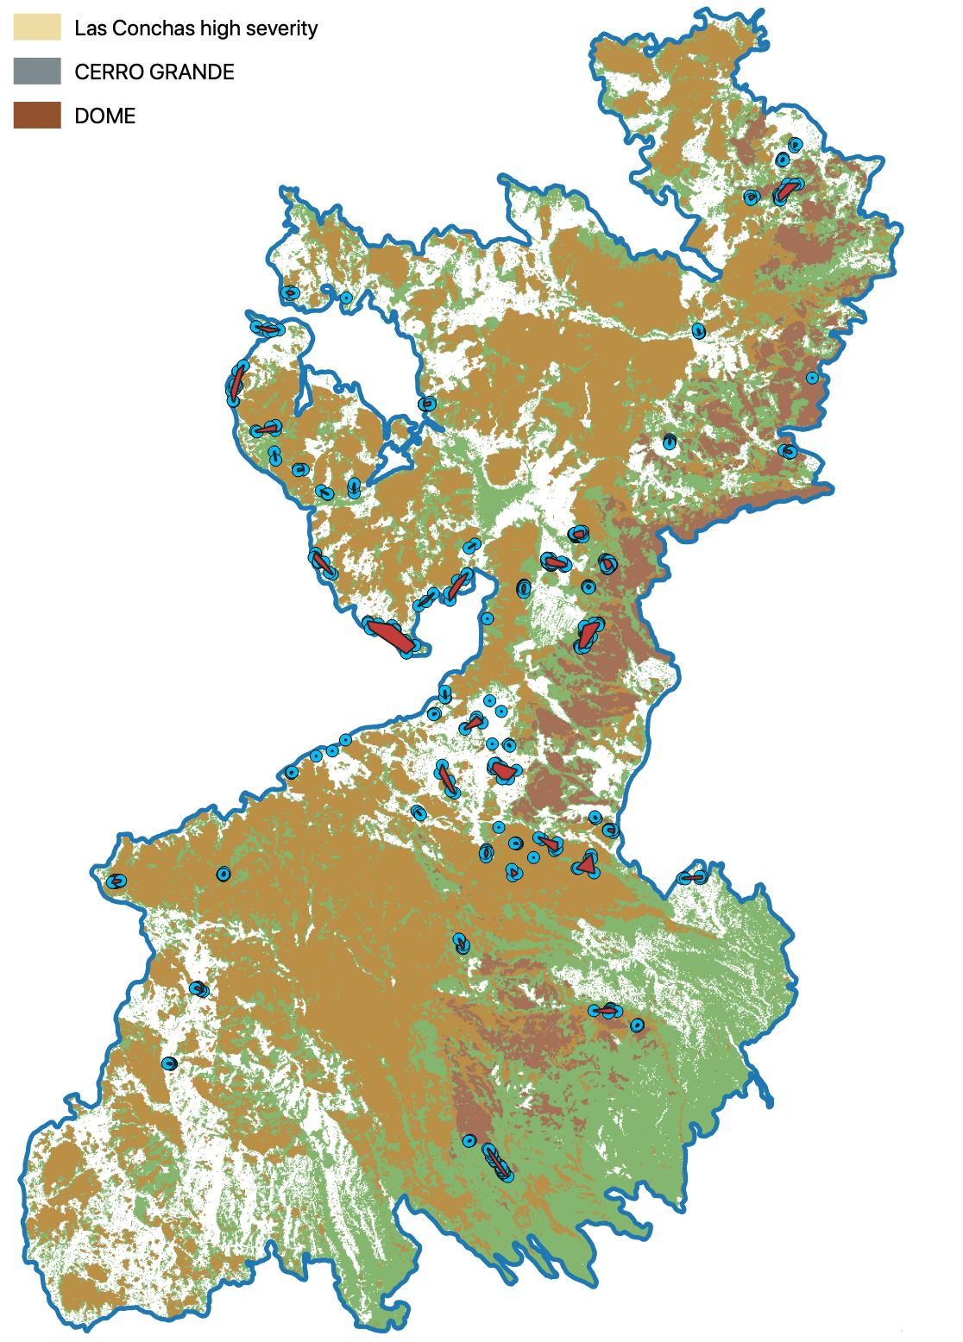
1: severity layers - stats
3 scenarios: lc, all, treeless
Scenario | % HS | % scars overlapped | % clusters overlapped
lc | 35.4%
all | 42.8%
treeless | 65.5%

Slide 6
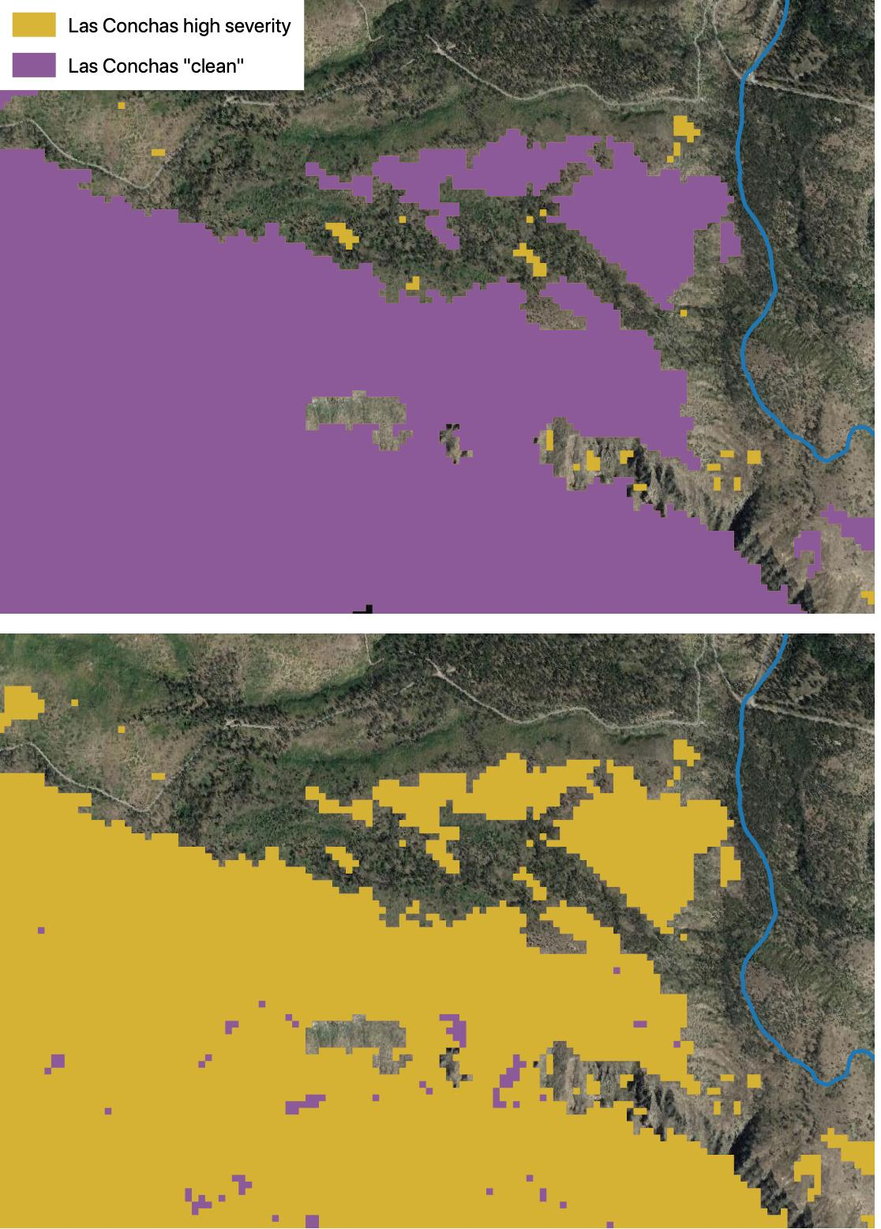
2: processing severity layers
“clean” each scenario
Remove “crumbs” < 1 ha (11 px)
Remove “holes” < 1 ha (11 px)
Updated script to run on raster layers; much faster.

Slide 7
2: processing severity layers
“clean” each scenario
Remove “crumbs” < 1 ha (11 px)
Remove “holes” < 1 ha (11 px)
Updated script to run on raster layers; much faster.
“cut” the cleaned polygons at pinch points for more realistic patch size distribution
Iteratively buffer every polygon inward by 15 m.
Keep doing this until no more 10 ha chunks are created.
Then repeat the process with 30, 60 and 120 m buffer increments.

Slide 8
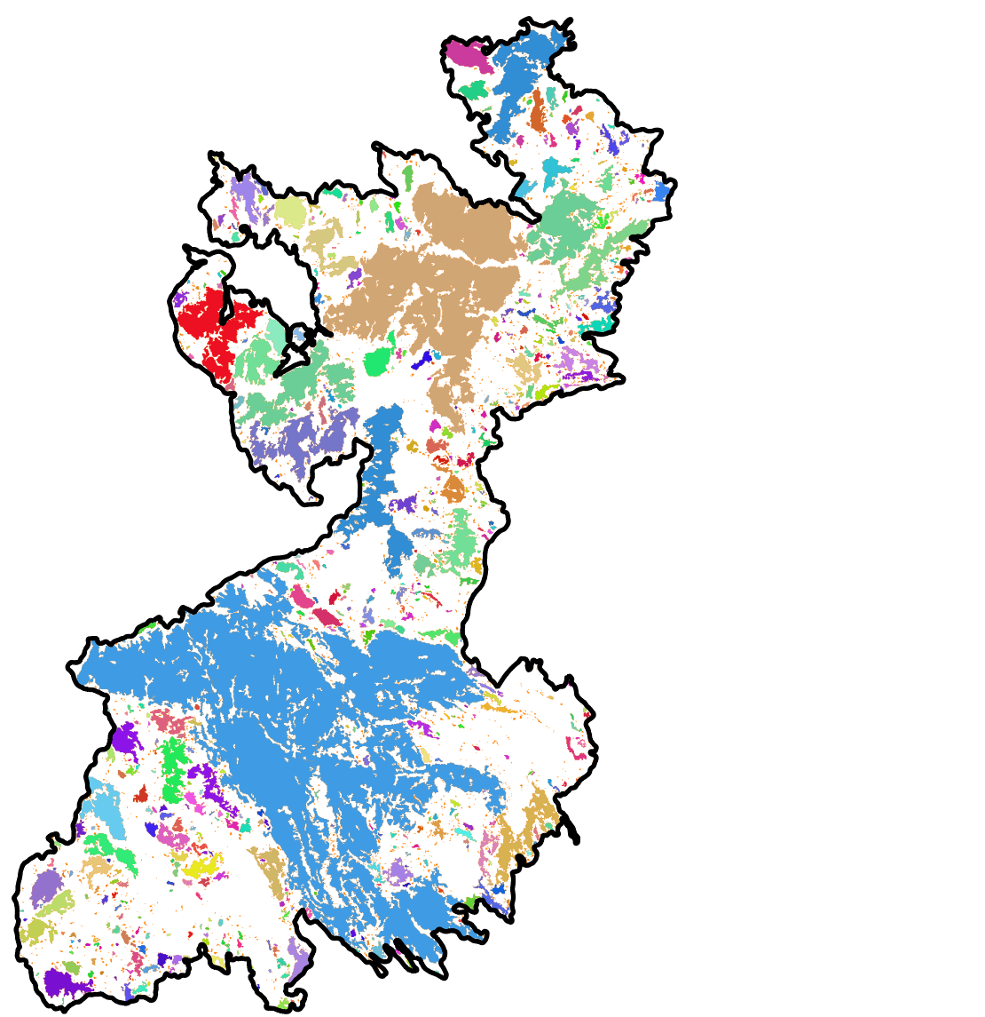
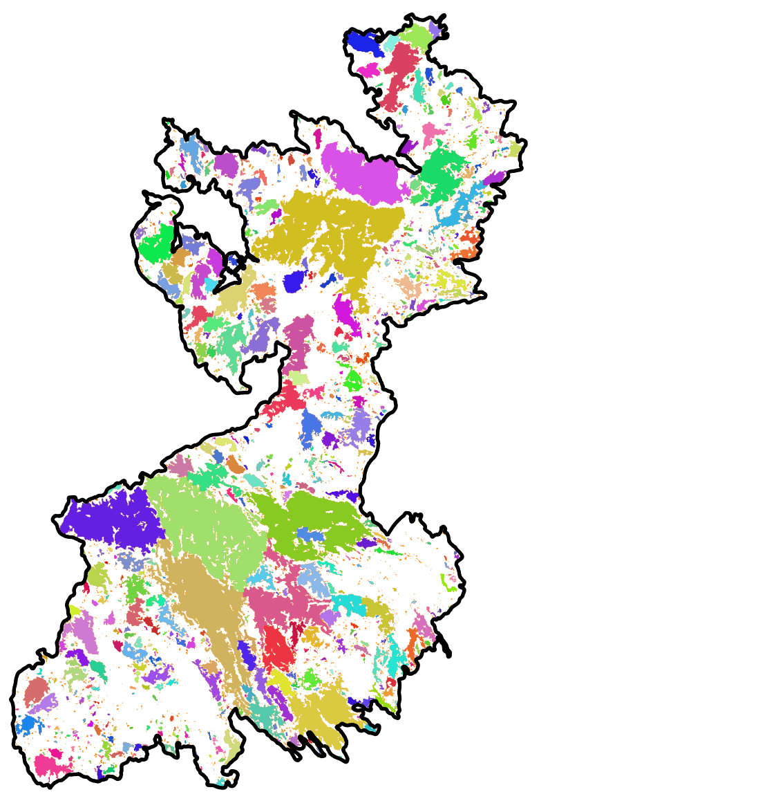
2: processing severity layers (nothing new here)
Cut
Clean-Uncut
Fatter, shorter tail here (among patches >10 ha)

Slide 9
3: patch distributions – simulating reality
First pass: fixed high-severity threshold
Tweak parameters
Range = 33m (0.25% of grid area)
Maximum range of autocorrelation
Nugget = 5
Variation in range (unknown units)
In this example for Las Conchas (35.4% hs), we take the top ~35.4% of the pixels from the distribution and then process (“clean and cut”)
35.4%

Slide 10
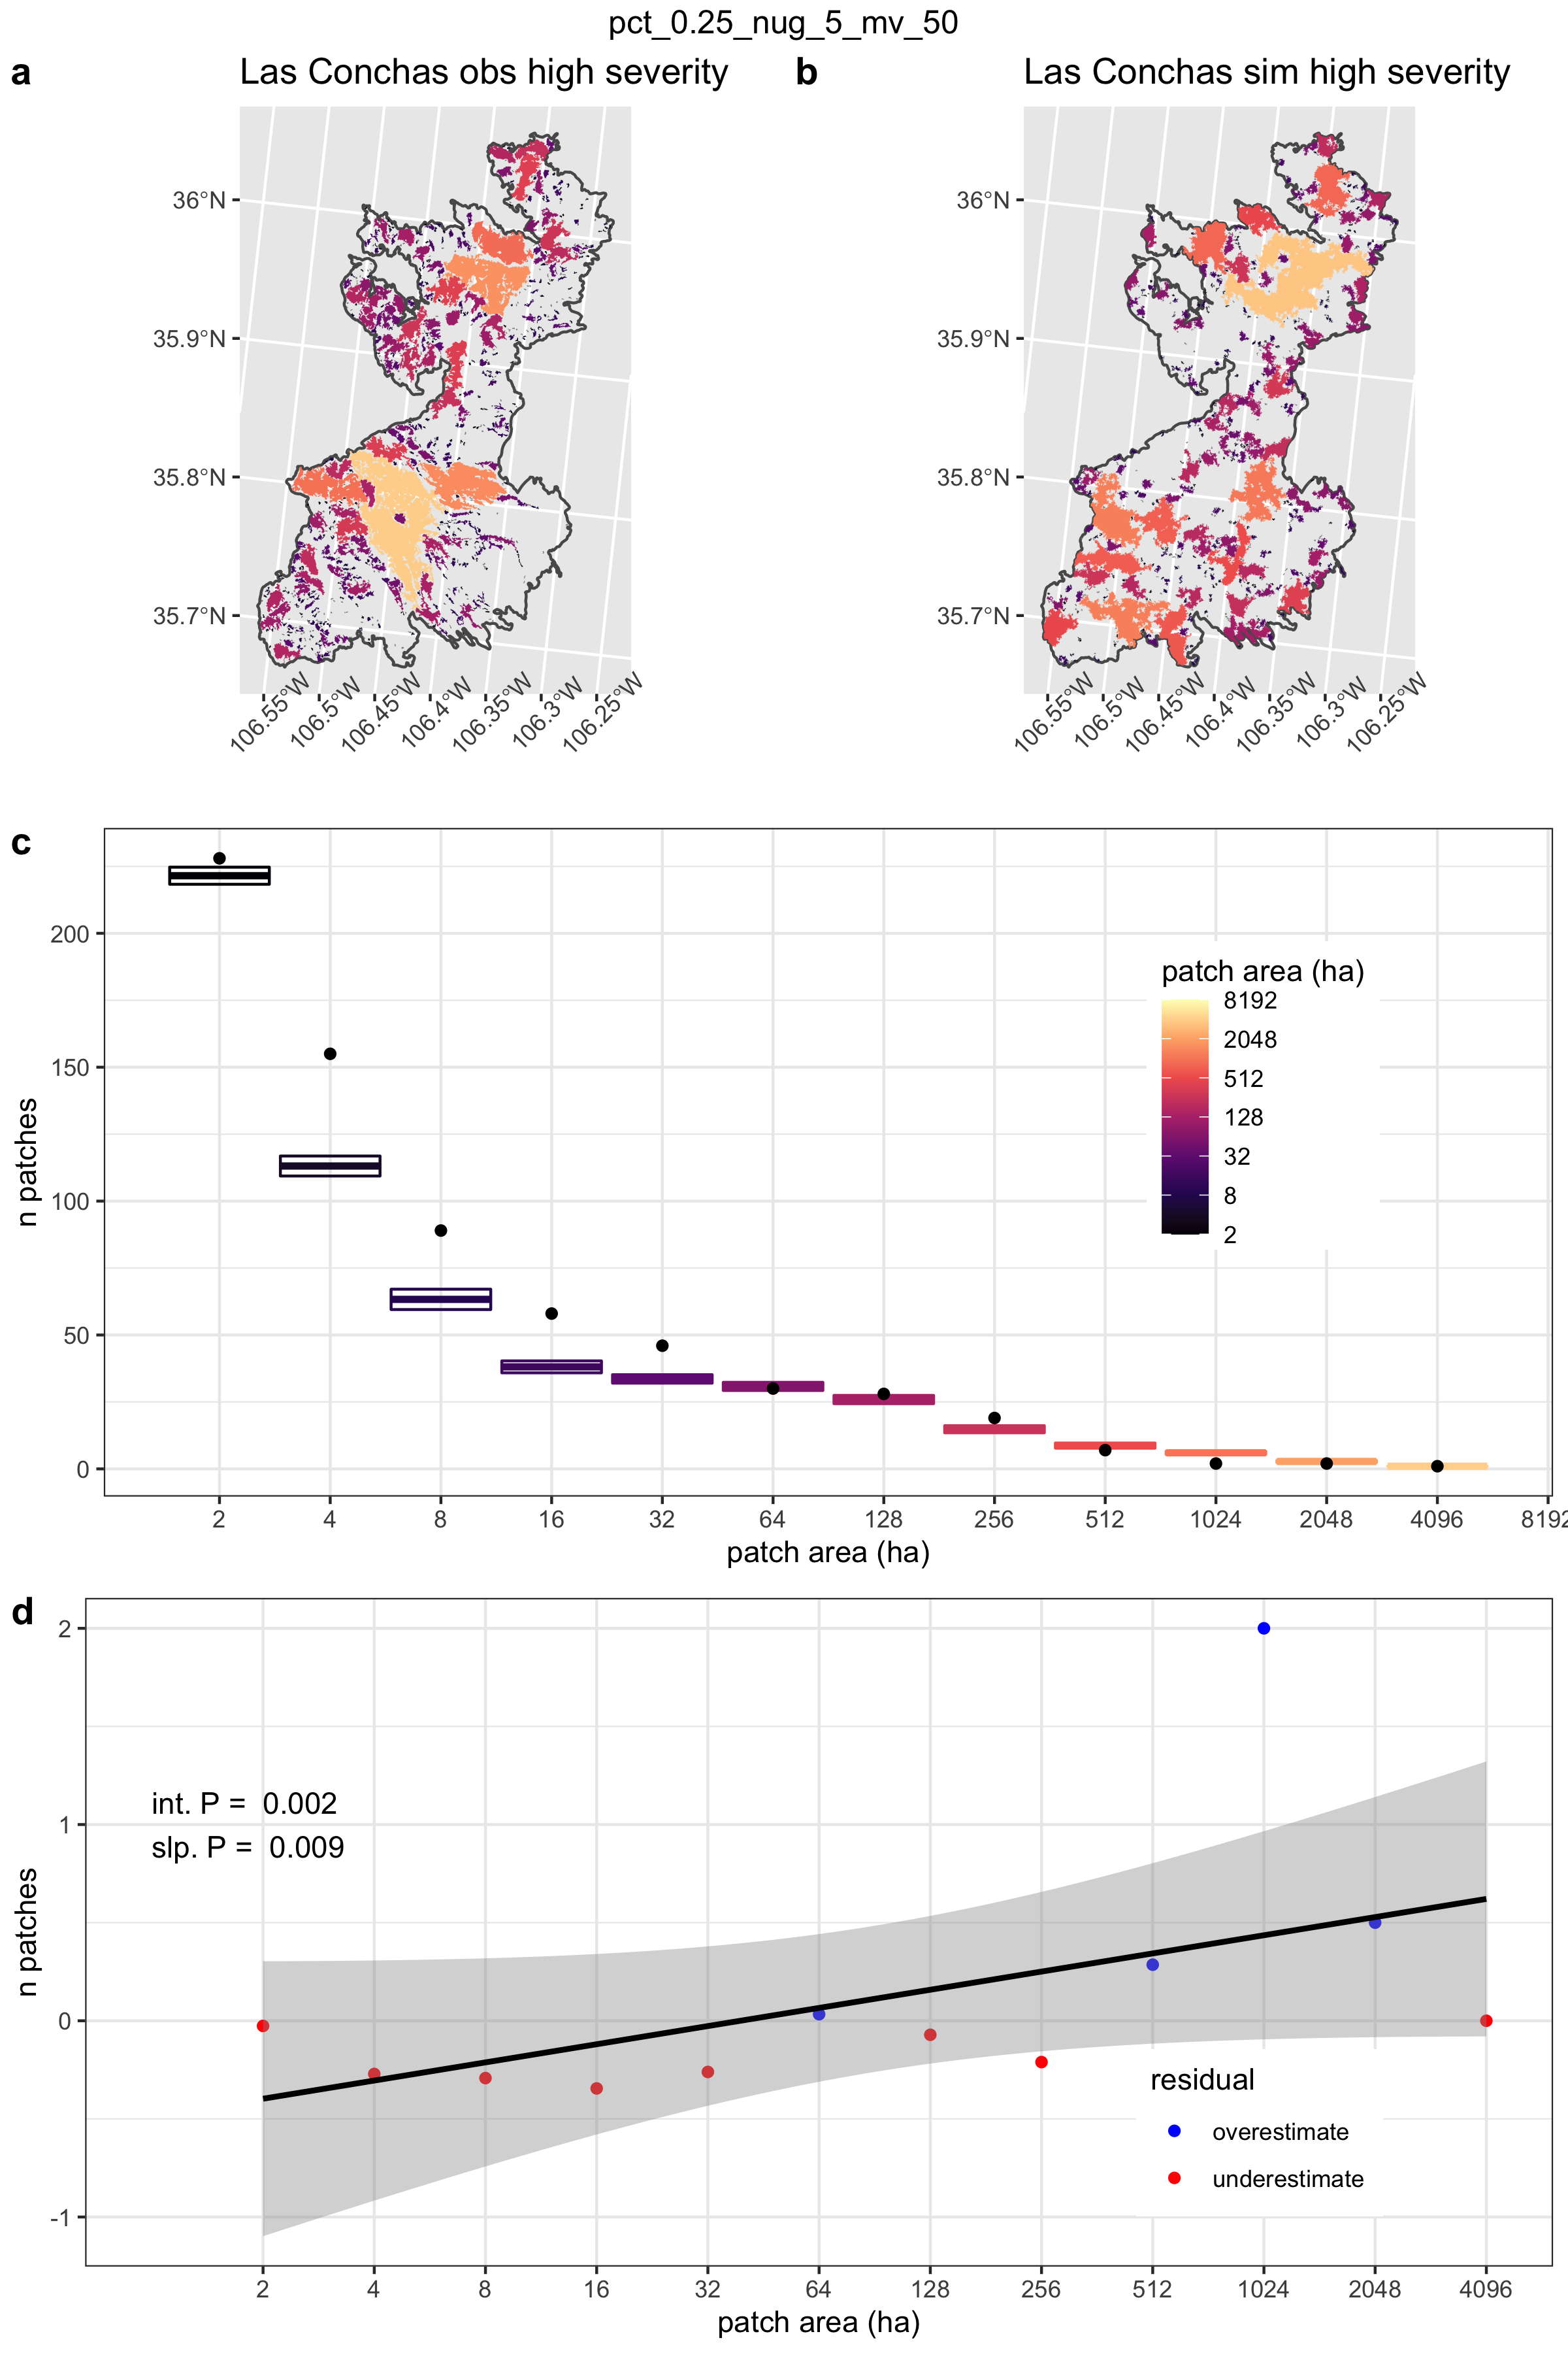
3: patch distributions – simulating reality
Compare simulation to reality
Do this ~10 times to generate distribution

Slide 11
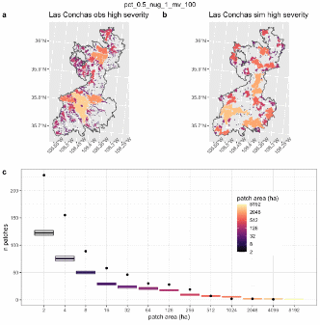
3: patch distributions – simulating reality
Compare simulation to reality
Modify parameters and compare distributions.
Pick the best parameter set and modify from there

Slide 12
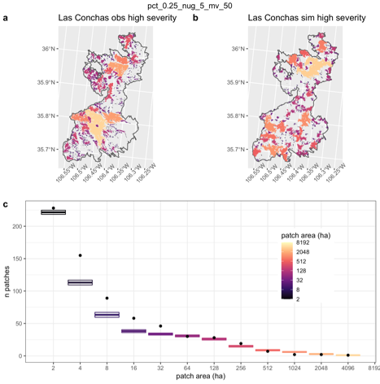
3: patch distributions – simulating reality
Compare simulation to reality
Modify parameters and compare distributions.
Pick the best parameter set and modify from there
Got to this local optimum in January
Range = 33 m (0.25%)
Nugget = 5
continued tinkering wasn’t making much difference

Slide 13
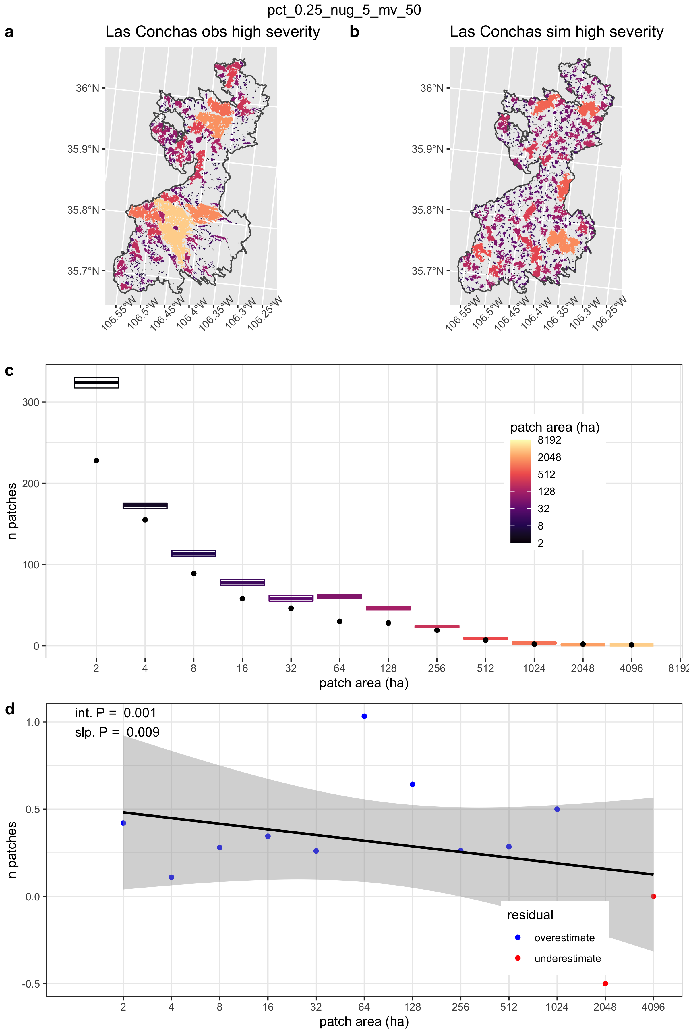
3: patch distributions – simulating reality
How to get more ~small patches?
Second pass: multiple high-severity thresholds instead of a single one.
35.4%
selected
selected

Slide 14
3: patch distributions – simulating reality
How to get more ~small patches?
Second pass: multiple high-severity thresholds instead of a single one.
Second pass simulations
Gaussian field sample
1-14% and > 75%
Range = 33 m (0.25%)
Nugget = 5

Slide 15
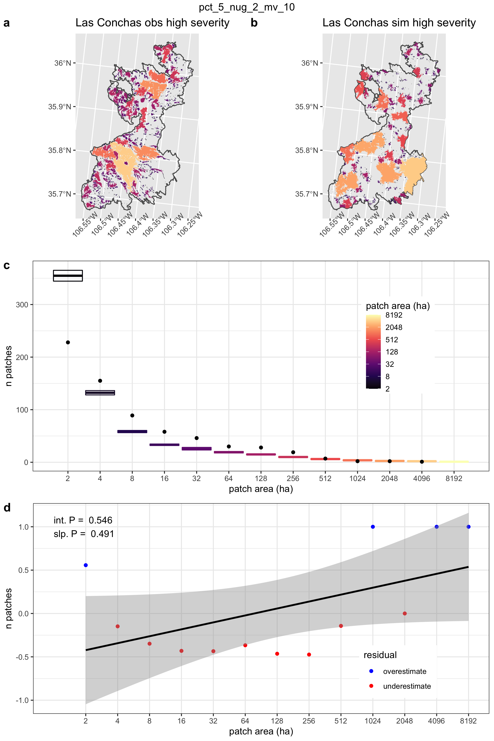
3: patch distributions – simulating reality
How to get more ~small patches?
Second pass: multiple high-severity thresholds instead of a single one.
Second pass simulations
Gaussian field sample
1-14% and > 75%
Range = 149 m (5%)
Nugget = 2

Slide 16
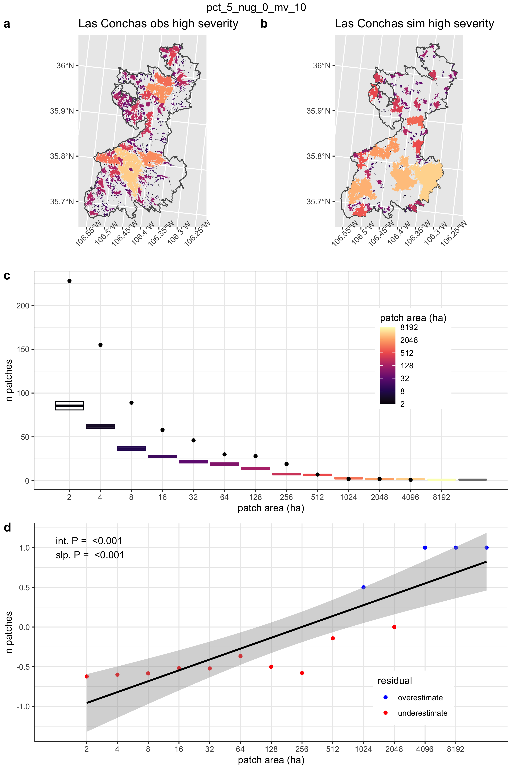
3: patch distributions – simulating reality
How to get more ~small patches?
Second pass: multiple high-severity thresholds instead of a single one.
Second pass simulations
Gaussian field sample
1-12% and > 75%
Range = 149 m (5%)
Nugget = 0

Slide 17
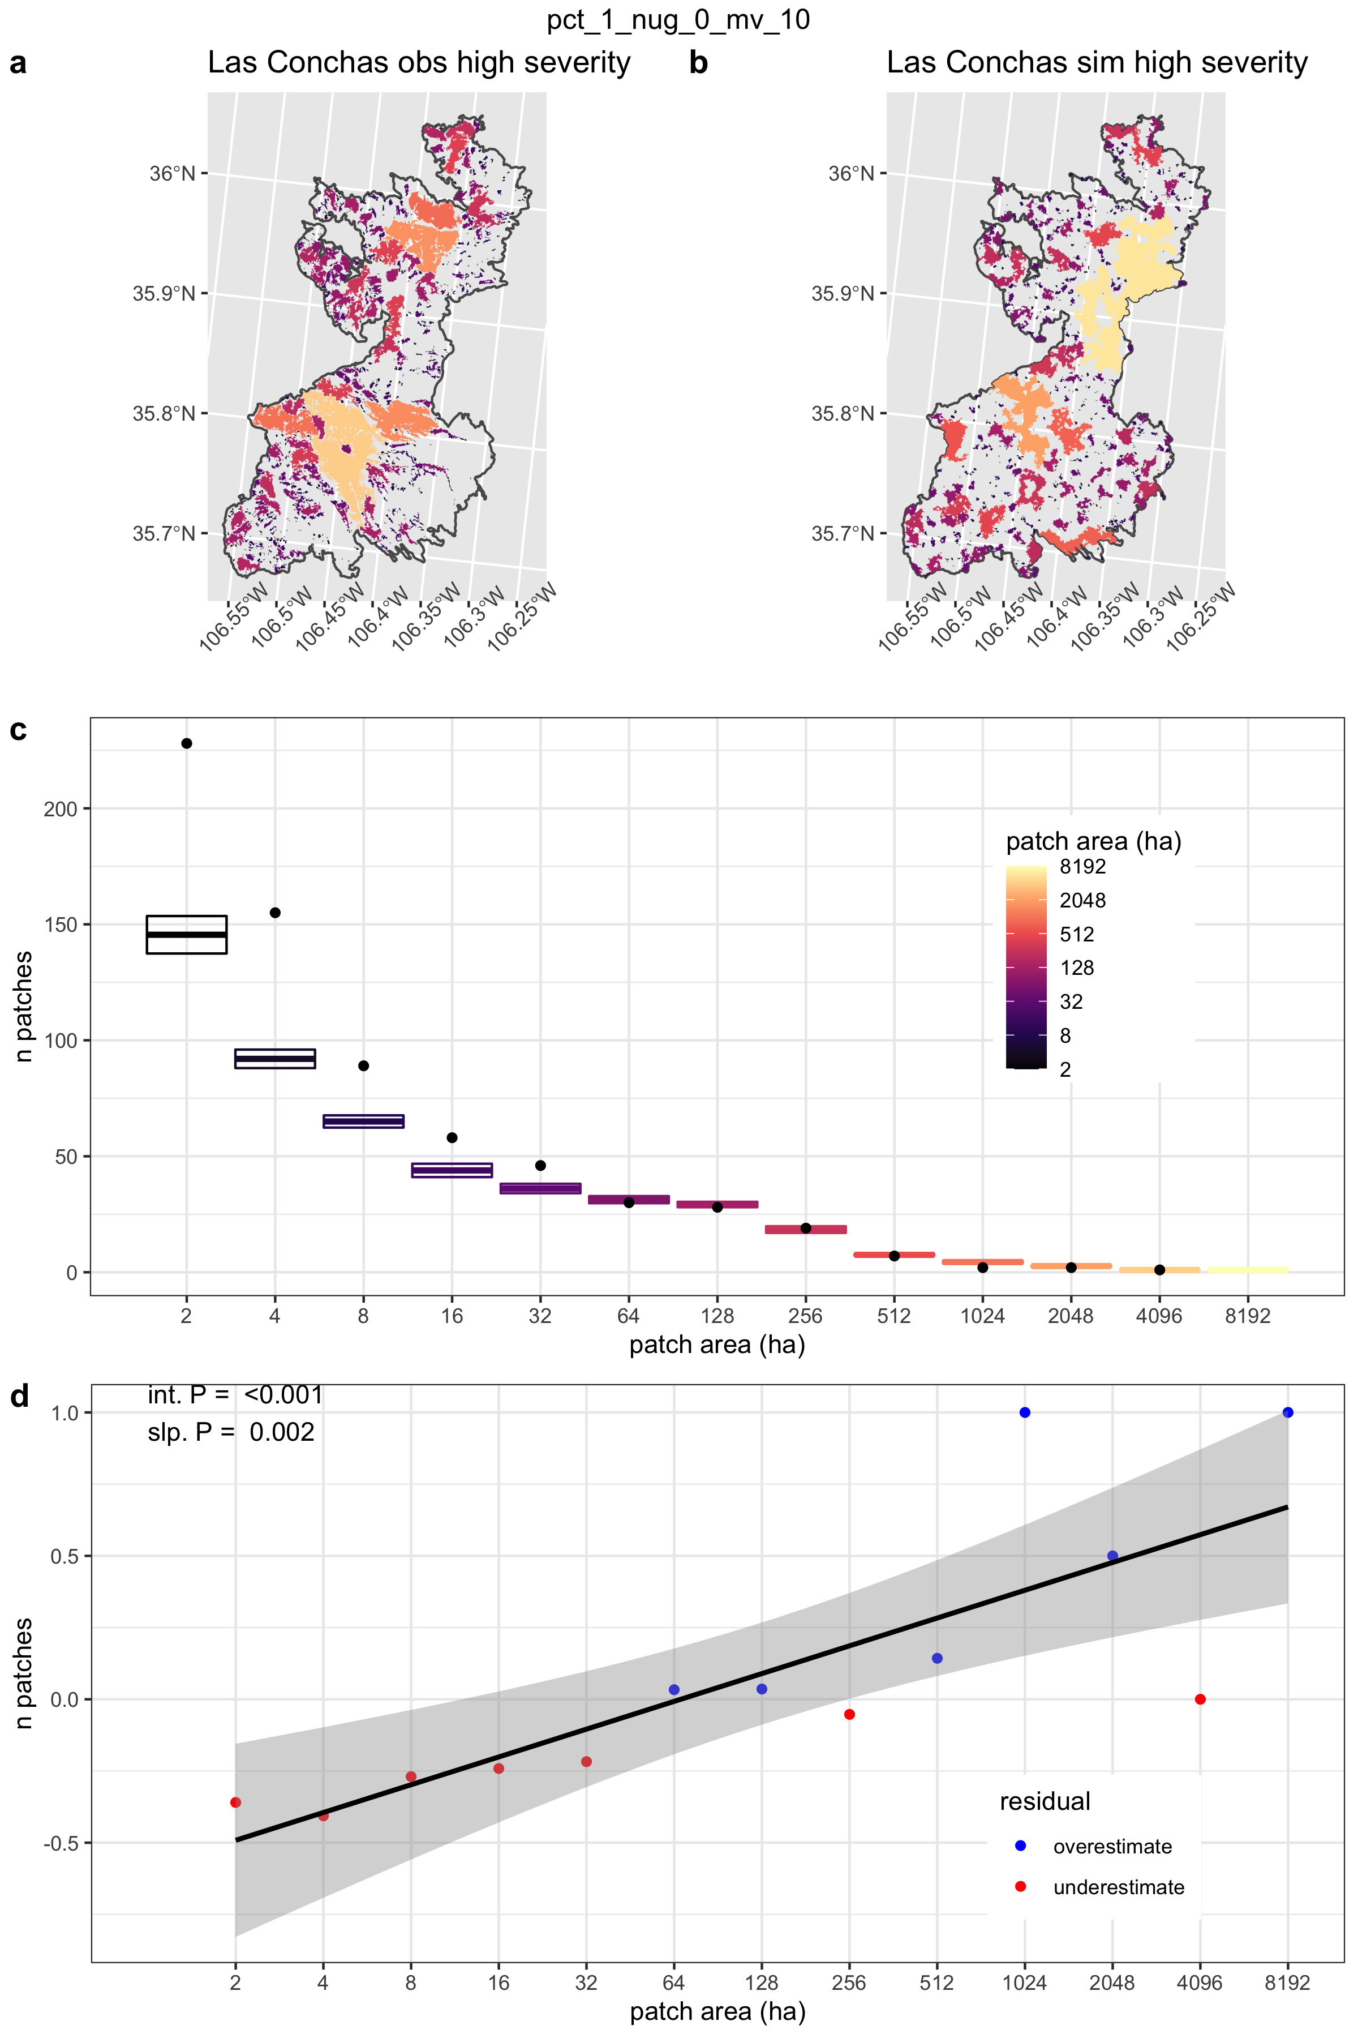
3: patch distributions – simulating reality
How to get more ~small patches?
Second pass: multiple high-severity thresholds instead of a single one.
Second pass simulations
Gaussian field sample
1-12% and > 75%
Range = 67 m (1%)
Nugget = 0

Slide 18
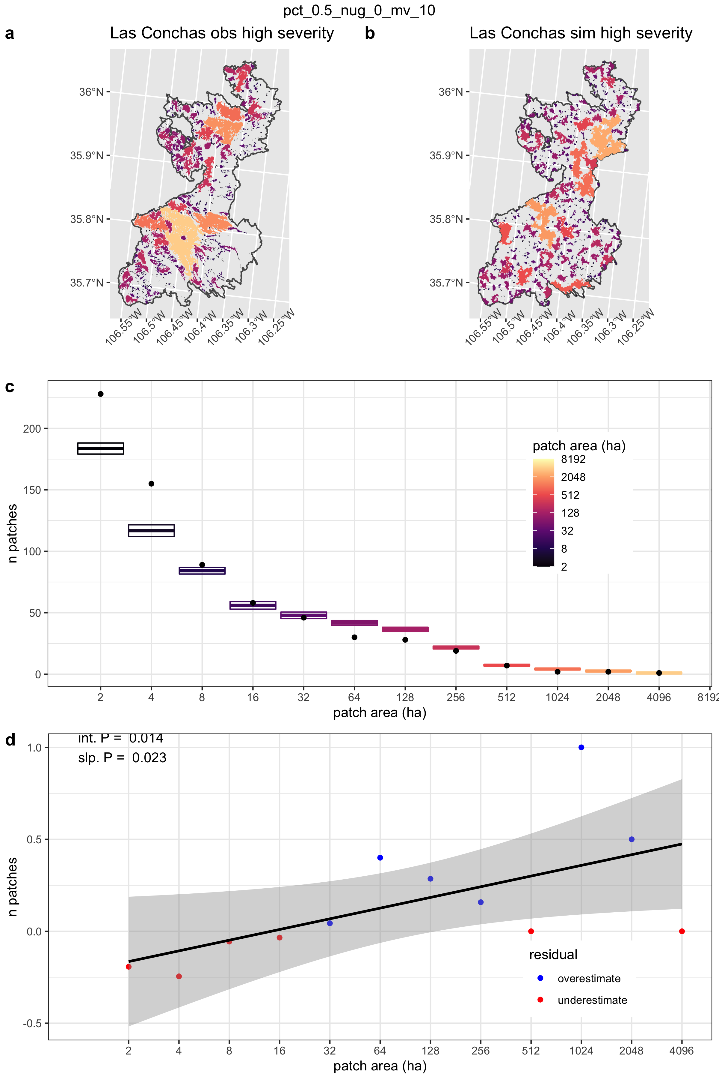
3: patch distributions – simulating reality
How to get more ~small patches?
Second pass: multiple high-severity thresholds instead of a single one.
Second pass simulations
Gaussian field sample
1-12% and > 75%
Range = 47 m (0.5%)
Nugget = 0

Slide 19
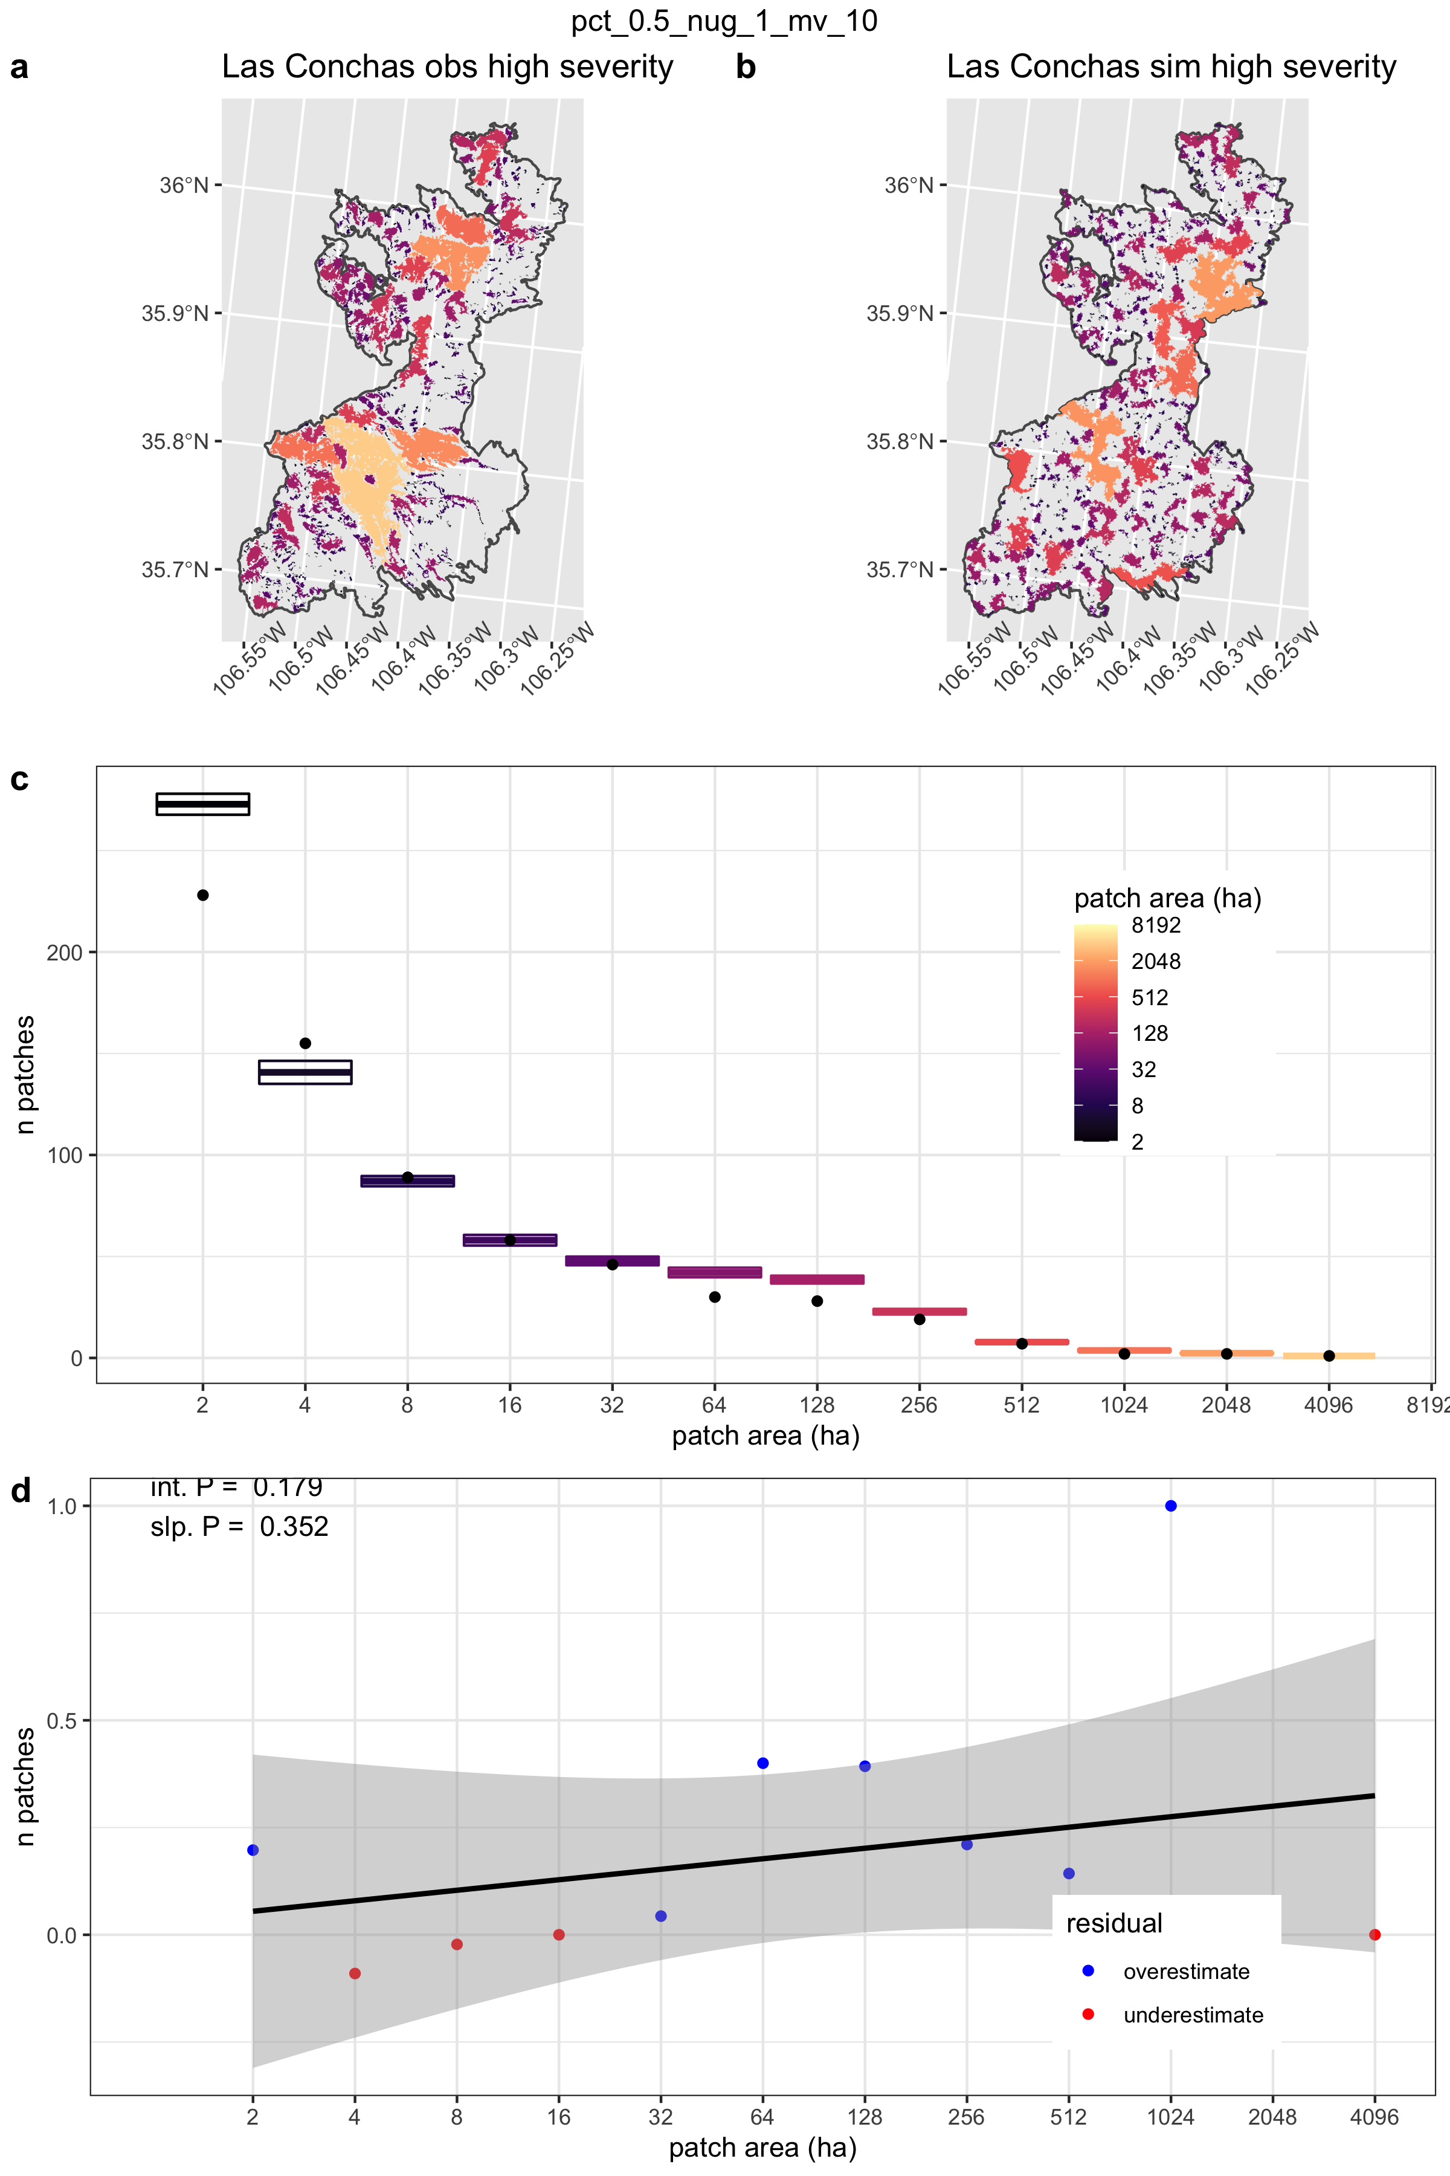
3: patch distributions – simulating reality
How to get more ~small patches?
Second pass: multiple high-severity thresholds instead of a single one.
Second pass simulations
Gaussian field sample
1-14% and > 75%
Range = 47 m (0.5%)
Nugget = 1

Slide 20
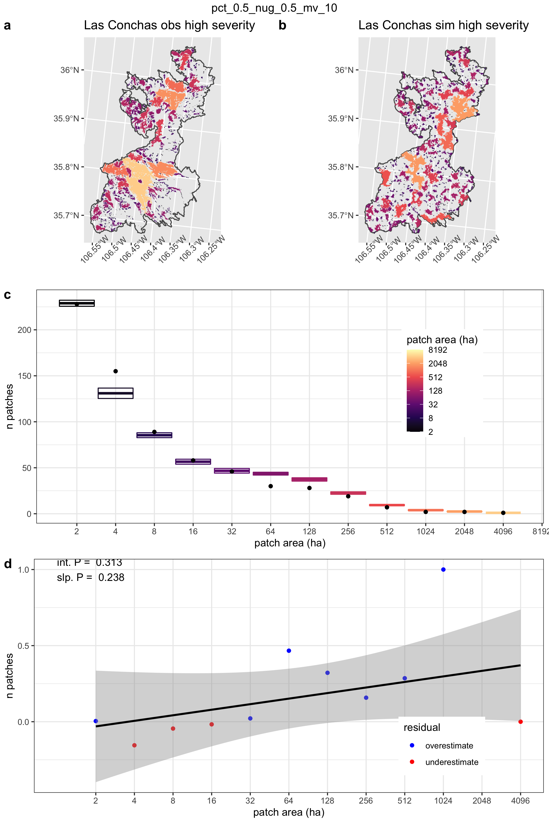
3: patch distributions – simulating reality
How to get more ~small patches?
Second pass: multiple high-severity thresholds instead of a single one.
Second pass simulations
Gaussian field sample
1-14% and > 75%
Range = 47 m (0.5%)
Nugget = 0.5

Slide 21
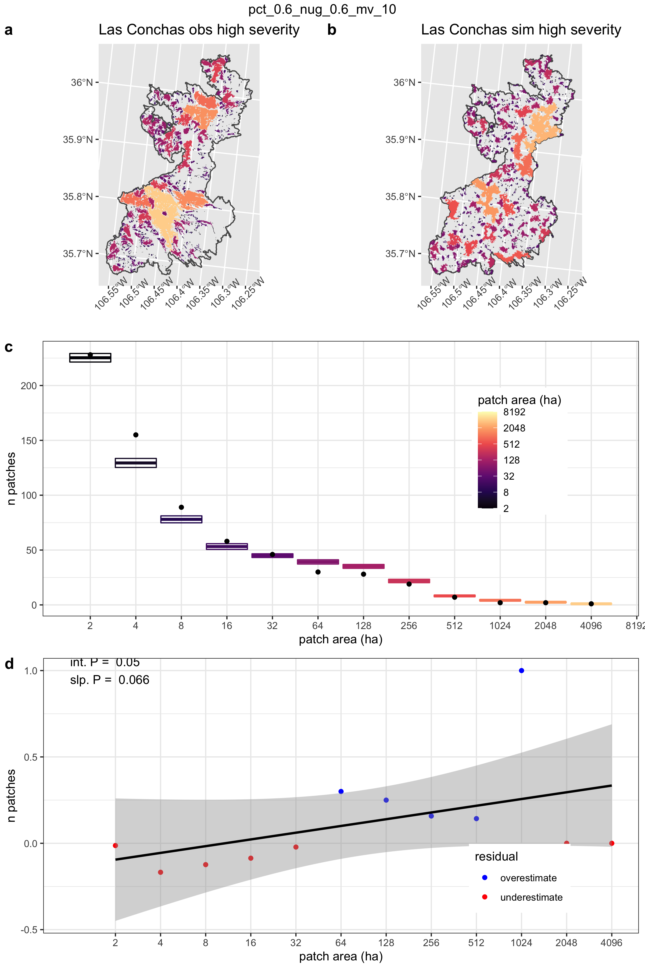
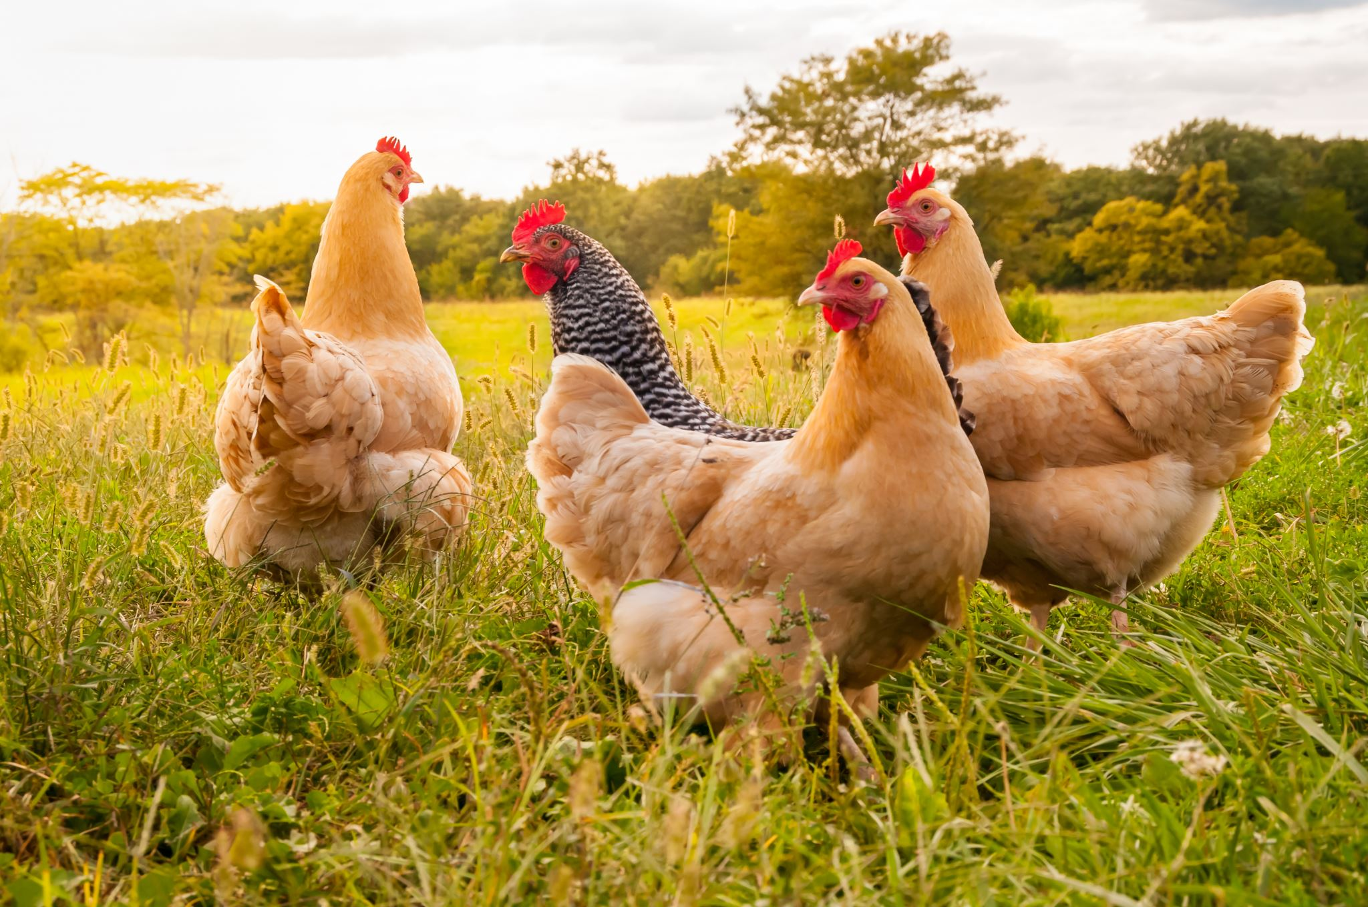
3: patch distributions – simulating reality
How to get more ~small patches?
Second pass: multiple high-severity thresholds instead of a single one.
Second pass simulations
Gaussian field sample
1-14% and > 75%
Range = 52 m (0.6%)
Nugget = 0.6
Winner winner chicken dinner

Slide 22
3: patch distributions – simulating reality
Some problems with this
It’s still not capturing reality perfectly (slight overestimation of mid-patches and underestimation of small ones)
Taking 2 sections of the distribution is not totally random (overdispersion of some small patches from some large ones)
I’ve explored much of the parameter space at this point, not sure there’s anything better possible with this approach
Have a few other ideas involving a complete overhaul, but need to move forward

Slide 23
4: scar intersection analyses
3 scenarios: lc, all, treeless
479 fire scarred trees
63 discrete clusters (“dbscan clustering algorithm”)

Slide 24
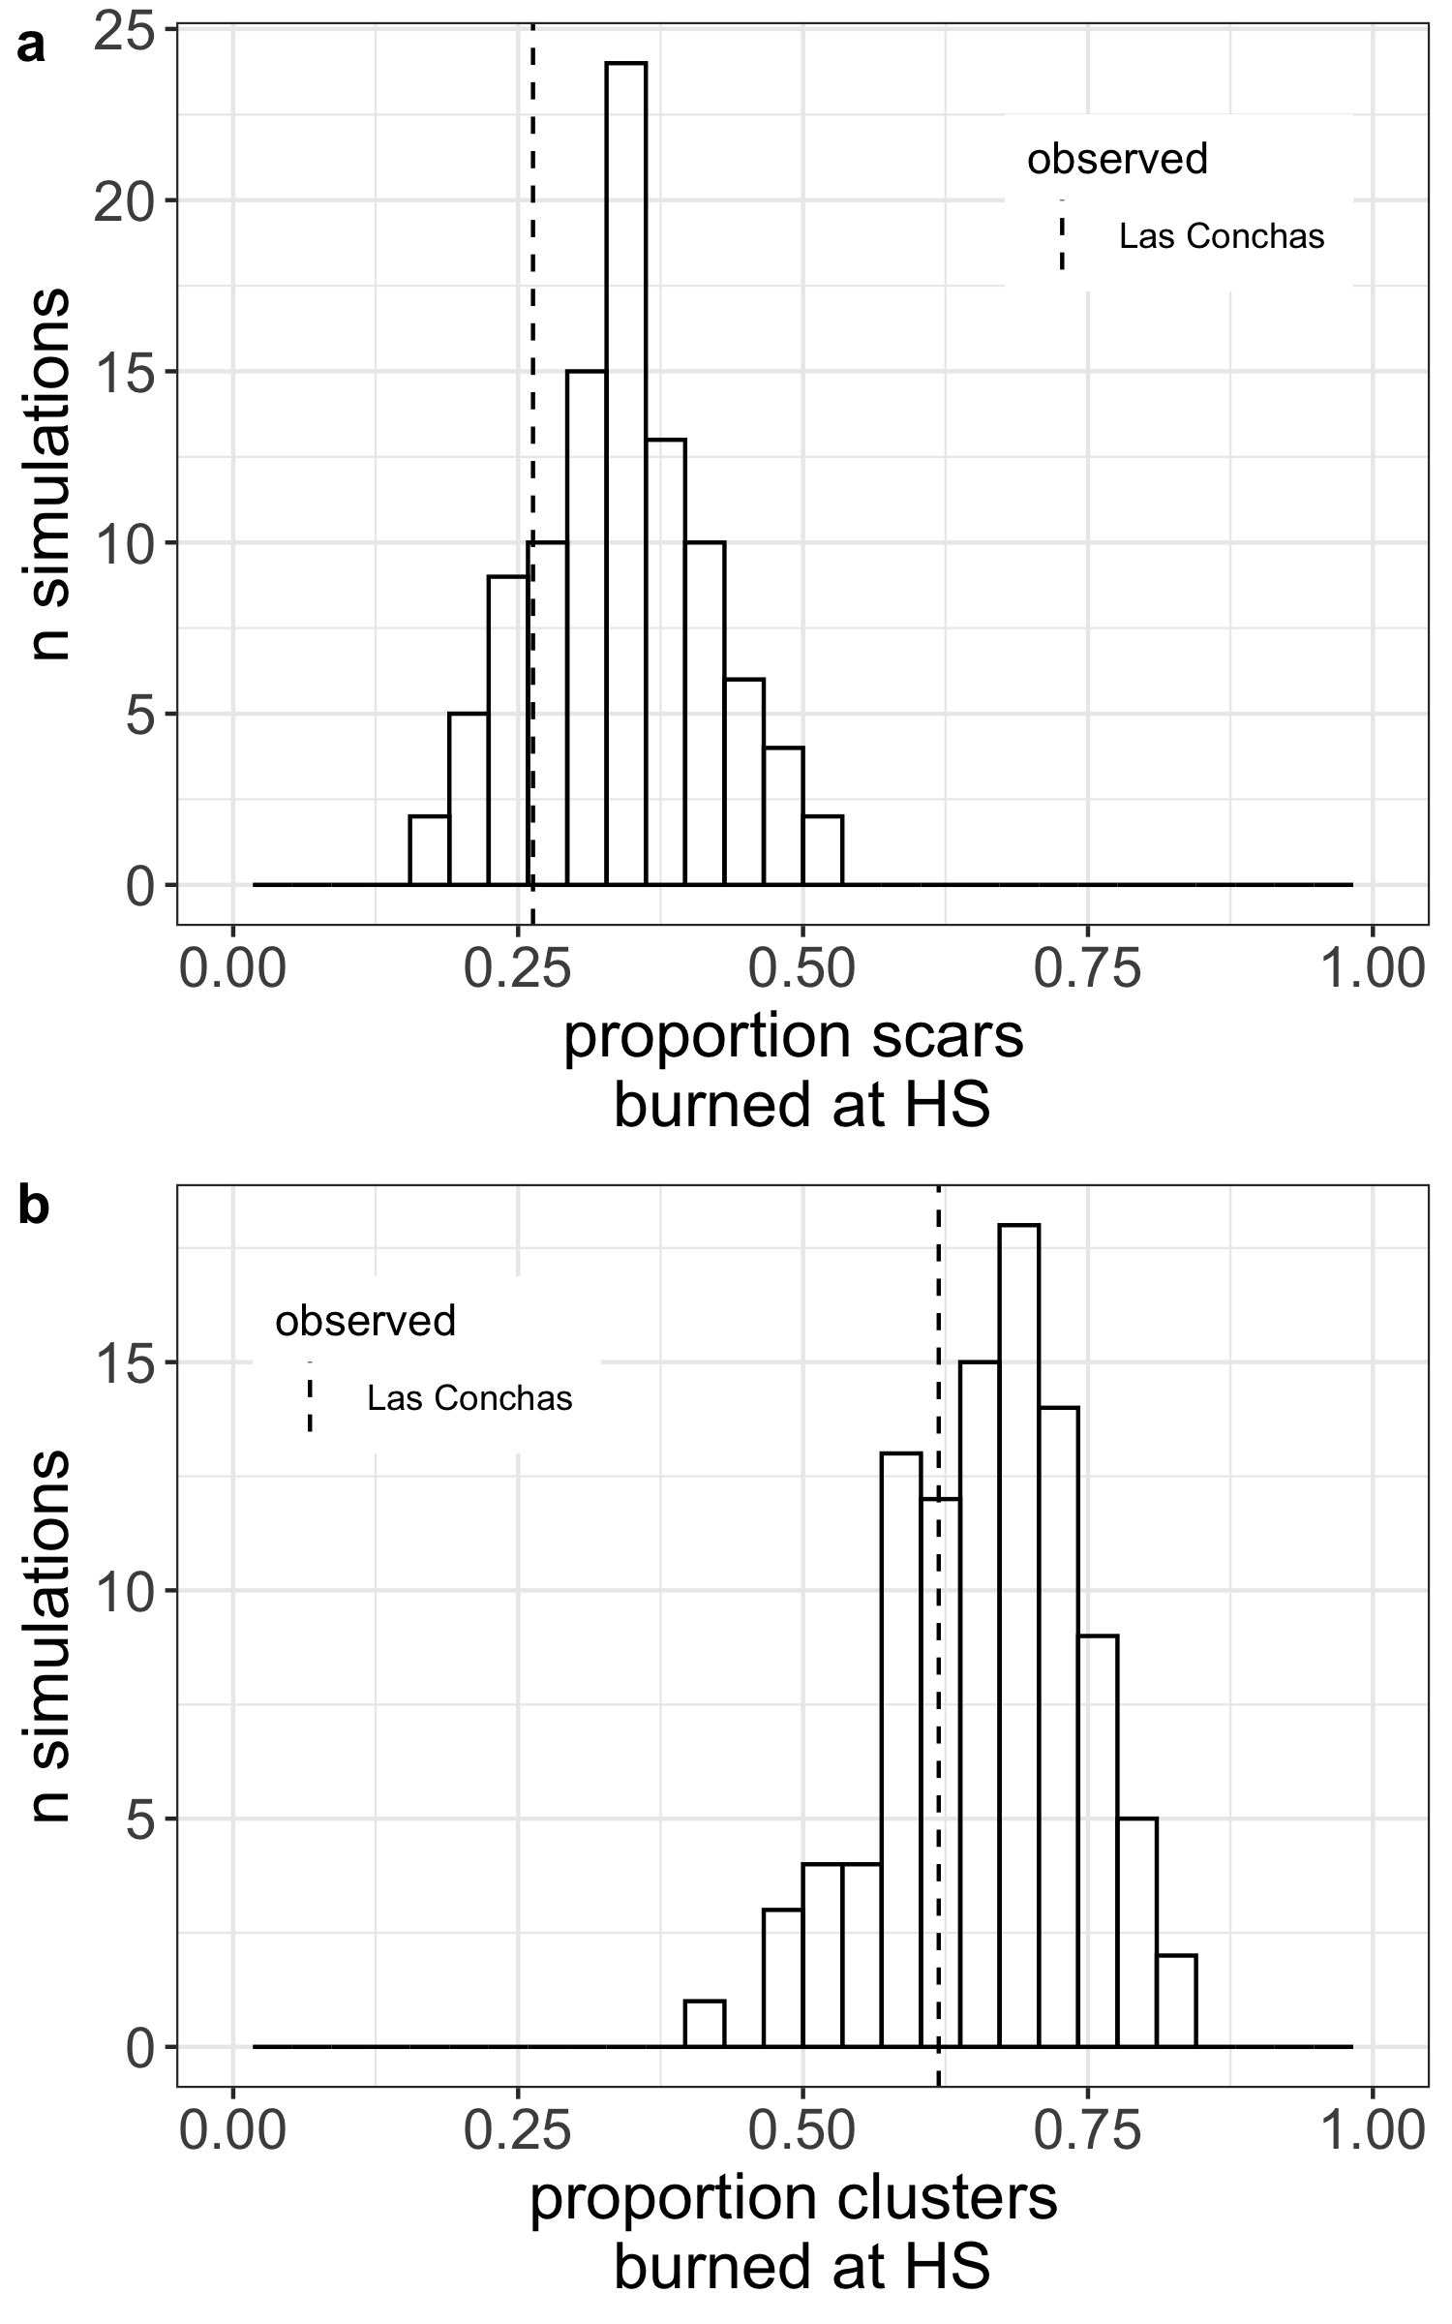
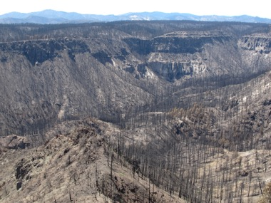
4: scar intersection analyses
observed
Hypothesis
If Las Conchas is representative of historical high-severity fire extent, then
fire scars (and clusters) should intersect minimally with high-severity burn areas compared to random
Note: Originally had also been thinking in terms of “number/proportion patches hitting a scar”, but this is more dependent on patch distribution than scar network properties.
Simulated random

Slide 25
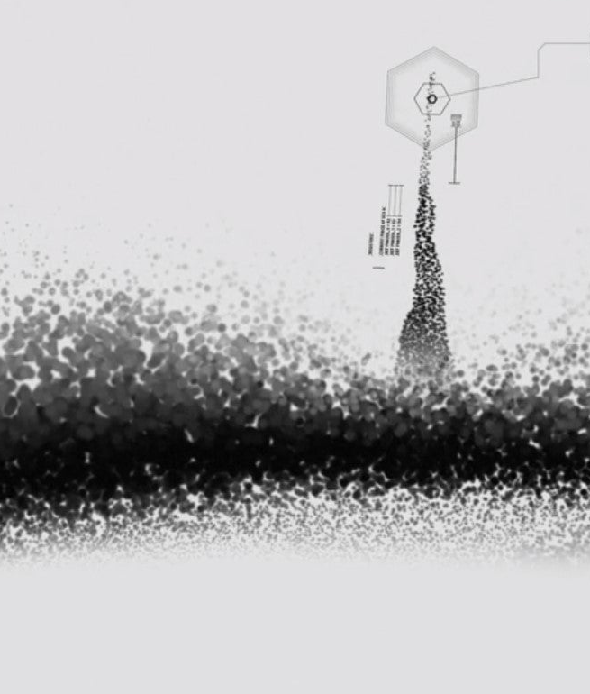
4: scar intersection analyses
Result 1
Compared to simulated random patches at 35% high severity, Las Conchas was in the
19th percentile for the proportion of scars burned at HS
26th percentile for the proportion of clusters with at least one tree burned at HS
Result 2
Zero instances of simulated fire avoiding all scars, at 35% high-severity
Conclusion
The Las Conchas fire resembled a random distribution of high-severity patches more than a “fire-scar avoiding” scenario
Las Conchas is inconsistent with even a conservative estimate of high-severity extent based solely on fire scar presence.
anomaly detected

Slide 26
4: scar intersection analyses
3 scenarios: lc, all, treeless
479 fire scarred trees
63 discrete clusters (“dbscan clustering algorithm”)
Comparison of scenarios:
Scenario | % HS | % scars overlapped | % clusters overlapped
lc | 35.4% | 26.3% | 61.9%
all | 42.8% | 35.1% | 74.6% (wrong, should be 63.5, intersection error)
treeless | 65.5% | 53% | NA – treeless clean cut layer is WRONG

Slide 27
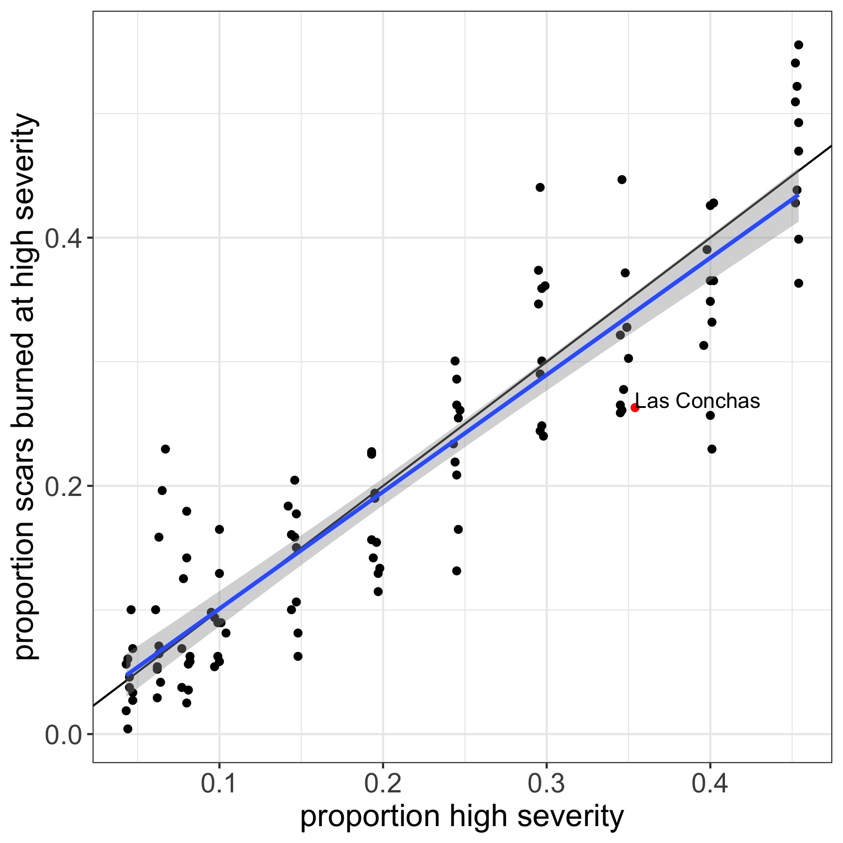
Bonus Question!
Given current best-fit aggregation parameters, how does fire scar intersection scale with proportion high-severity?
Linear fit
How do the aggregation parameters influence fire scar intersection for a given proportion high-severity?

Slide 28
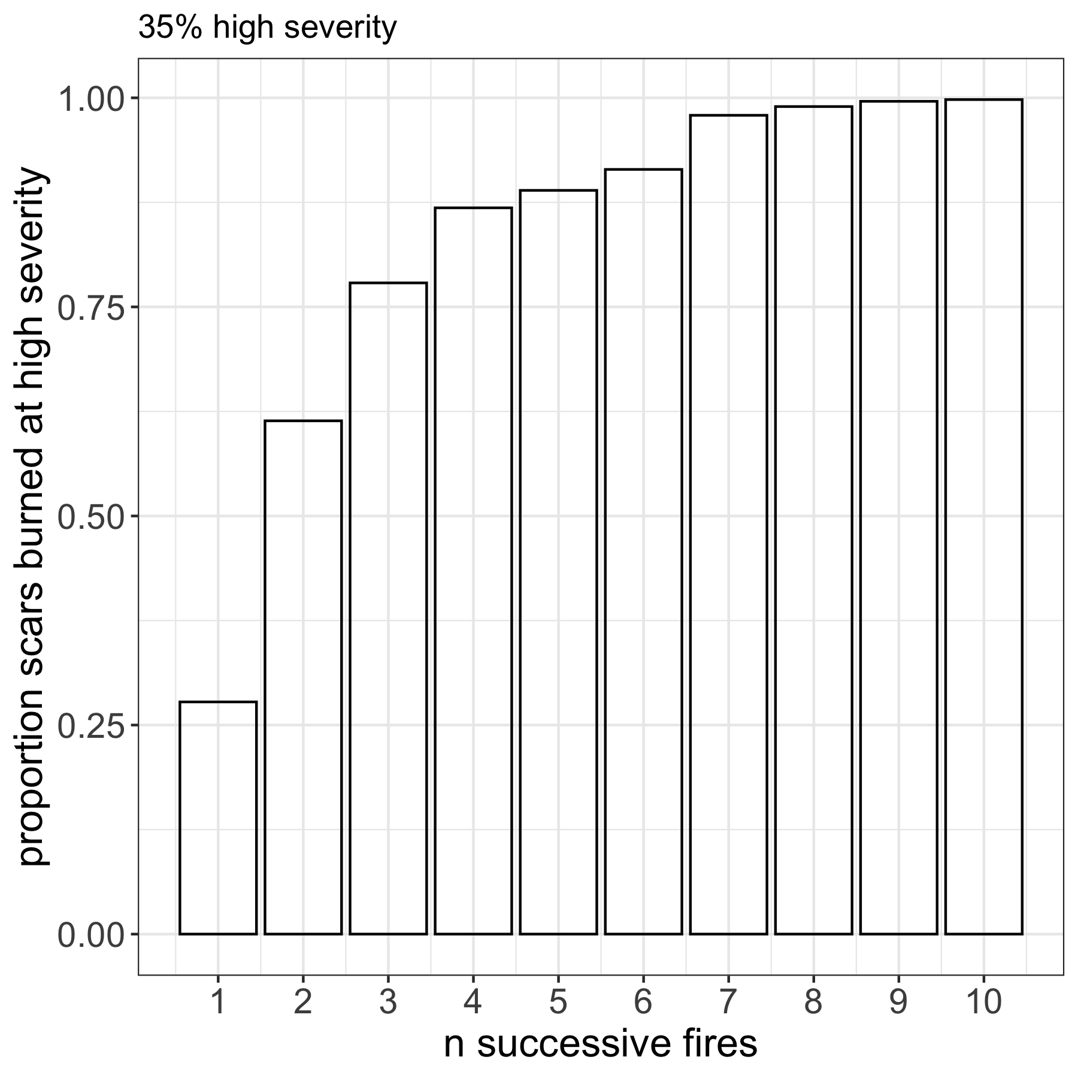
Another Bonus Question!
This is just one fire event. If this is characteristic fire behavior, how many repeat fires will eliminate all fire scars?
Recall the ~10 year fire return interval
Answer: About 7 (~70 years)
Notes:
Craig has some concerns about this analytical approach in his email.

Slide 29
4: scar intersection analyses
What else do we want to ask?

